Slide 1
Linguistics 200, Week 13
Writing Systems

Slide 2
Timeline for Remainder of Cousre
Today: finishing up writing systems
Wednesday (11/20): work on translating language for component 4,
Friday (11/22): work on final project, start preparing for translation
Monday (11/25): work on final project, start preparing for translation; submit to me before break!
Monday (12/2): continue translating final projects; prepare for presentations; course evals
If your project is ready to go by the end of 12/2, I'll make reference audio for you!
Wednesday (12/4): continue working on final projects
Friday (12/6): begin final presentations

Slide 3

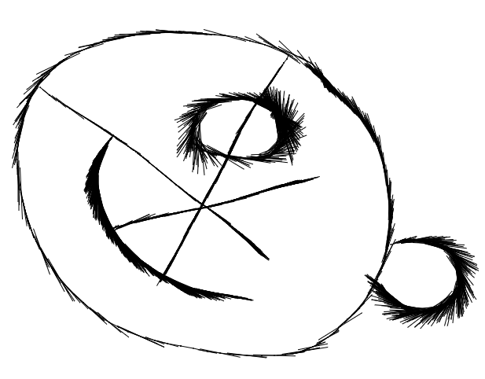
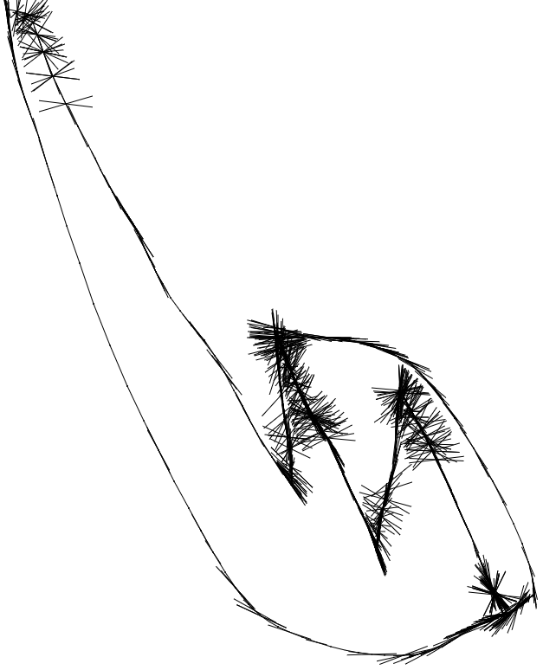
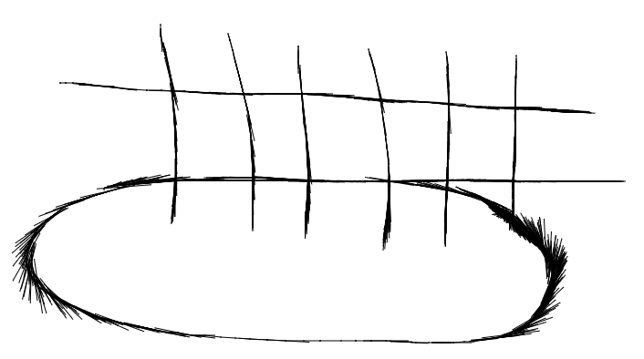
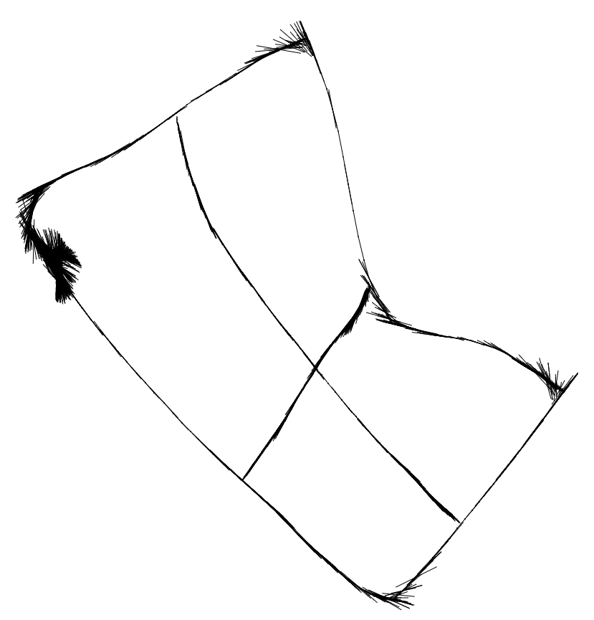
Last week: 15 symbols

Slide 4
Today: let's add 5 more!
https://sketch.io/sketchpad/

Slide 5
Review
Writing Systems
"Phonographic" Systems

Slide 6
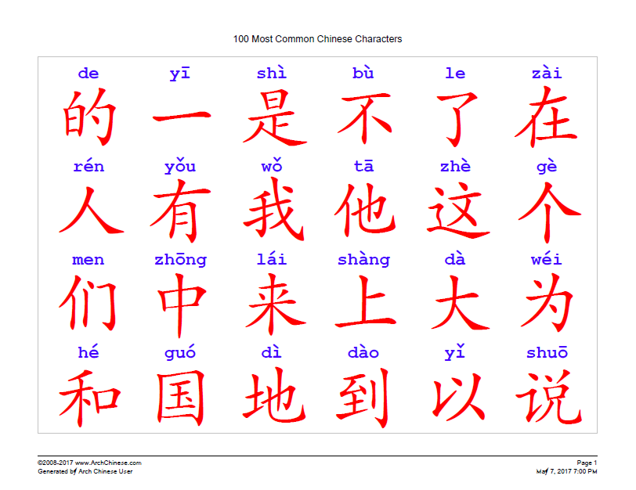
Chinese

Slide 7
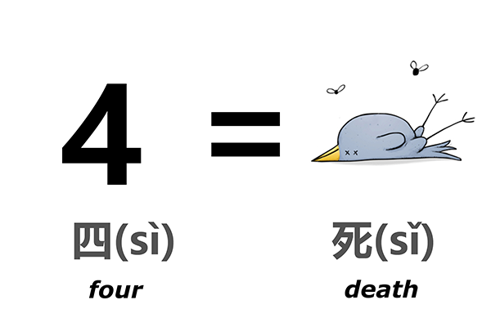

Slide 8
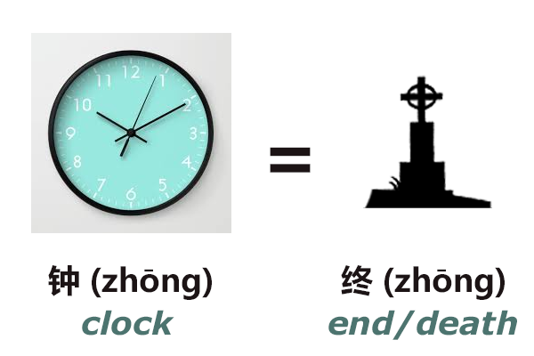

Slide 9
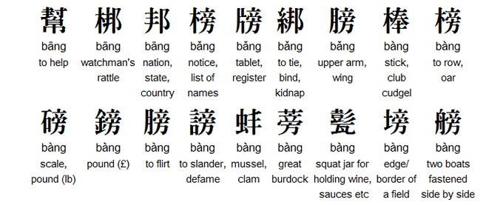
Every word has its own unique sign.

Slide 10
Homophones =/= Homographs
English has tons of these, too. (Even though English has an alphabet, there are a ton of logographic features within it):
To / two / too
Beat / beet
Ail / ale
Fir / fur
Sweet / suite
Tacks / tax

Slide 11
What it could look like:
< ne >
“and”
< ʀiɴɤ >
“city”
< çiɴ >
“wife”
< sɤpainoɭ>
“king”
< wisi >
“under”

Slide 12
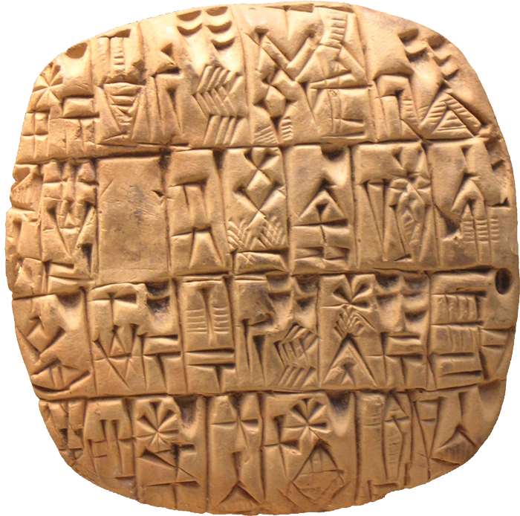
Why would you choose a logographic system?

Slide 13


Logograms mixed w/ phonograms: determinatives
John vs. john

Slide 14
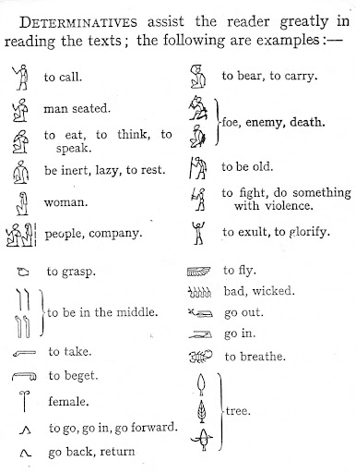
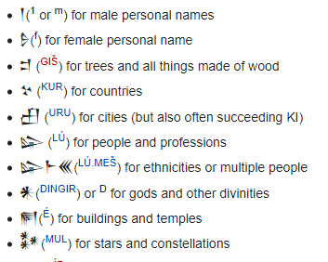
Determinatives

Slide 15
Okay, what should Dorgon (Pxsinunr) have?
unb! sa galasjul pfode. sa gpfapfa ekesxdg-aŋk-on pfode.
ikacoɳɟa, kθu ekebase sxdo ekepfodg-aŋk-on.
modlx-ekexon-a ekesxa ekebase sxdo.
p-eke:mg-iŋ ekesxa bace-bke-mb sxdo ekebzomp.
brpu-psi-gpfa, ikakdasion ubz-im-on ça basenasaθ.
unb! sa dumbldimpf pfa. sa dpθmɳima pfa. dzu-solix ipam pfa.
unb! su udo pfopkin sxden.

Slide 16
What Elijah decided

Slide 17
Component 4 - Pull up Model
3. What type of writing system does your conlang use? If your system writes sounds -- is it an alphabet, an abjad, an alphasyllabary (abugida), or a syllabary? If it is a logographic system, how does your system create new words (i.e., in what way can your logographic system write sounds?)?

Slide 18
Component 4 - Pull up Model
4. Show, in detail, how your writing system works, complete with illustrations and examples. (If you choose to take a picture of your system to include it in your project component, this is fine, but make sure it is legible.)
If you choose an alphabet or an abjad, you must create characters for all sounds in your language.
If you choose to make an alphasyllabary, syllabary, or logographic system, you must create at least 20 original symbols for your language.

Slide 19
Component 4 - Pull up Model
5. For this last question, you will be asked to first translate three sentences from English into your conlang. You will then write out these sentences using your newly constructed writing system. As before, make sure that your answers are LEGIBLE.
a. Where do you come from?
b. I speak __________ (name of your language).
c. If you can understand this, you know too much.

Slide 20
Linguistics 200, Week 13
Writing Systems

Slide 21
Timeline for Remainder of Cousre
Today: work on translating language for component 4
Friday (11/22): work on final project, start preparing for translation
Monday (11/25): work on final project, start preparing for translation; submit to me before break!
Monday (12/2): continue translating final projects; prepare for presentations; course evals
If your project is ready to go by the end of 12/2, I'll make reference audio for you!
Wednesday (12/4): continue working on final projects
Friday (12/6): begin final presentations

Slide 22
Translating Sentences in Component 4
a. Where do you come from?
b. I speak __________ (name of your language).
c. If you can understand this, you know too much.

Slide 23
Lexicon
Where ______
come _____
this ça

Slide 24
Linguistics 200, Week 13
Writing Systems

Slide 25
Timeline for Remainder of Cousre
Today: work on final project, start preparing for translation
Monday (11/25): work on final project, start preparing for translation; submit to me before break!
Monday (12/2): continue translating final projects; prepare for presentations; course evals
If your project is ready to go by the end of 12/2, I'll make reference audio for you!
Wednesday (12/4): continue working on final projects
Friday (12/6): begin final presentations

